Slide 1
Targetprocess k8s
June 2018

Slide 2

12k tests
~4h full build
1h < to deploy a hotfix

Slide 3
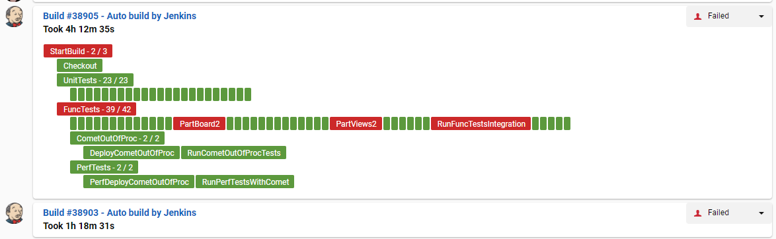

Slide 4
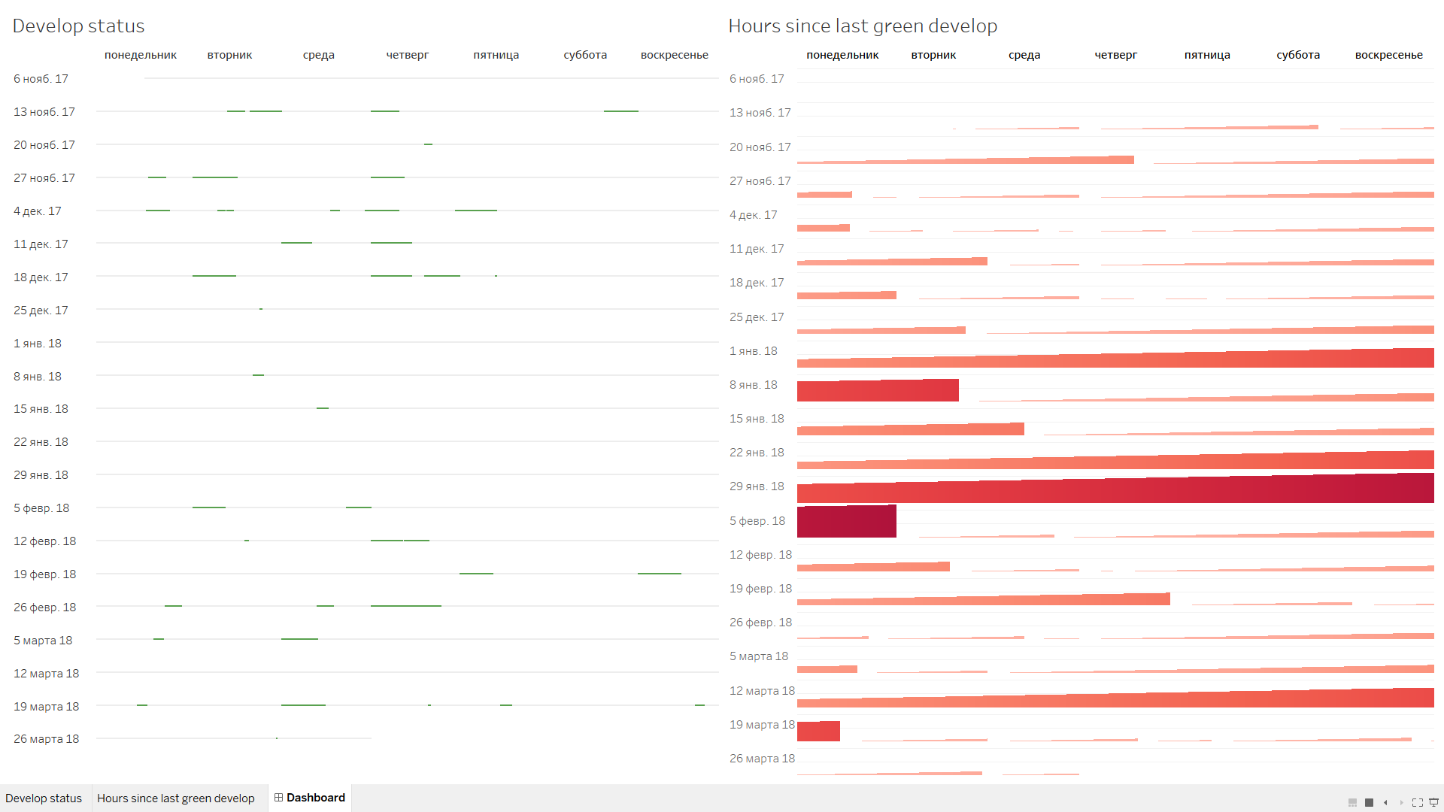
12k tests
4h < full build
1h < to deploy a hotfix

Slide 5
Microservices

Slide 6
Microservices

Slide 7

Microservices

Slide 8

Microservices

Slide 9



Microservices

Slide 10


Microservices

Slide 11

Microservices

Slide 12

Microservices

Slide 13
Microservices
x15

Slide 14
Infrastructure :
1. Logging
2. Metrics
3. Supervision
4. Persistence
5. Service Discovery
6. Infrastructure Automation
7. (Auto) Scaling
8. CI/CD
9. Vendor Independence
10. Multi language support

Slide 15
Docker

Slide 16
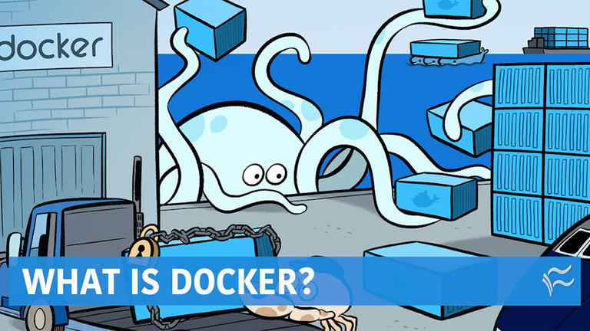

Slide 17
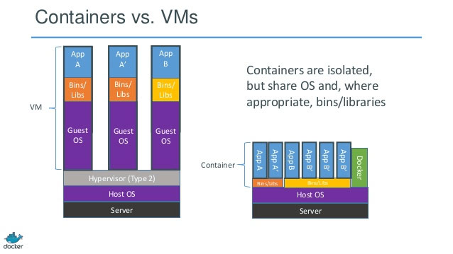

Slide 18
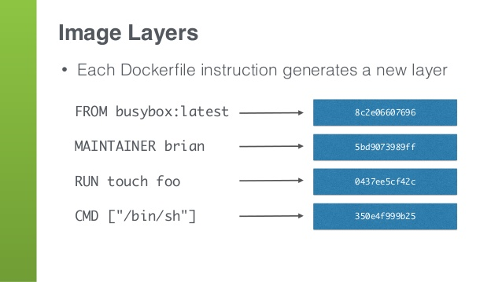

Slide 19
Orchestration

Slide 20





Slide 21

Kubernetes
Kubernetes is an open-source system for automating deployment, scaling, and management of containerized applications.

Slide 22
Kubernetes architecture

Slide 23
Kubernetes architecture:
YAM (Declarative DSL)
node-1
master
node-2

Slide 24
Kubernetes architecture:
YAM (Declarative DSL)
Docker
node-1
Docker
master
node-2

Slide 25
Kubernetes architecture:
YAM (Declarative DSL)
Docker
kubelet
node-1
Docker
kubelet
master
node-2

Slide 26
Kubernetes architecture:
YAM (Declarative DSL)
Docker
kubelet
kube-proxy
node-1
Docker
kubelet
kube-proxy
master
node-2

Slide 27
Kubernetes architecture:
YAM (Declarative DSL)
Docker
API
Server
kubelet
kube-proxy
node-1
Docker
kubelet
kube-proxy
master
node-2

Slide 28
Kubernetes architecture:
YAM (Declarative DSL)
Docker
etcd
API
Server
kubelet
kube-proxy
node-1
Docker
kubelet
kube-proxy
master
node-2

Slide 29
Kubernetes architecture:
YAM (Declarative DSL)
Docker
etcd
API
Server
kubelet
kube-proxy
node-1
Scheduler
Docker
kubelet
kube-proxy
master
node-2

Slide 30
Kubernetes architecture:
YAM (Declarative DSL)
Docker
etcd
API
Server
kubelet
kube-proxy
node-1
Controller-manager
Scheduler
Docker
kubelet
kube-proxy
master
node-2

Slide 31
Kubernetes architecture:
YAML (Declarative DSL)
Kubectl
Docker
etcd
API
Server
kubelet
kube-proxy
node-1
Controller-manager
Scheduler
Docker
kubelet
kube-proxy
master
node-2

Slide 32
Kubernetes architecture:
YAML
Kubectl
Docker
etcd
API
Server
kubelet
kube-proxy
node-1
Controller-manager
Scheduler
Docker
kubelet
kube-proxy
master
node-2

Slide 33
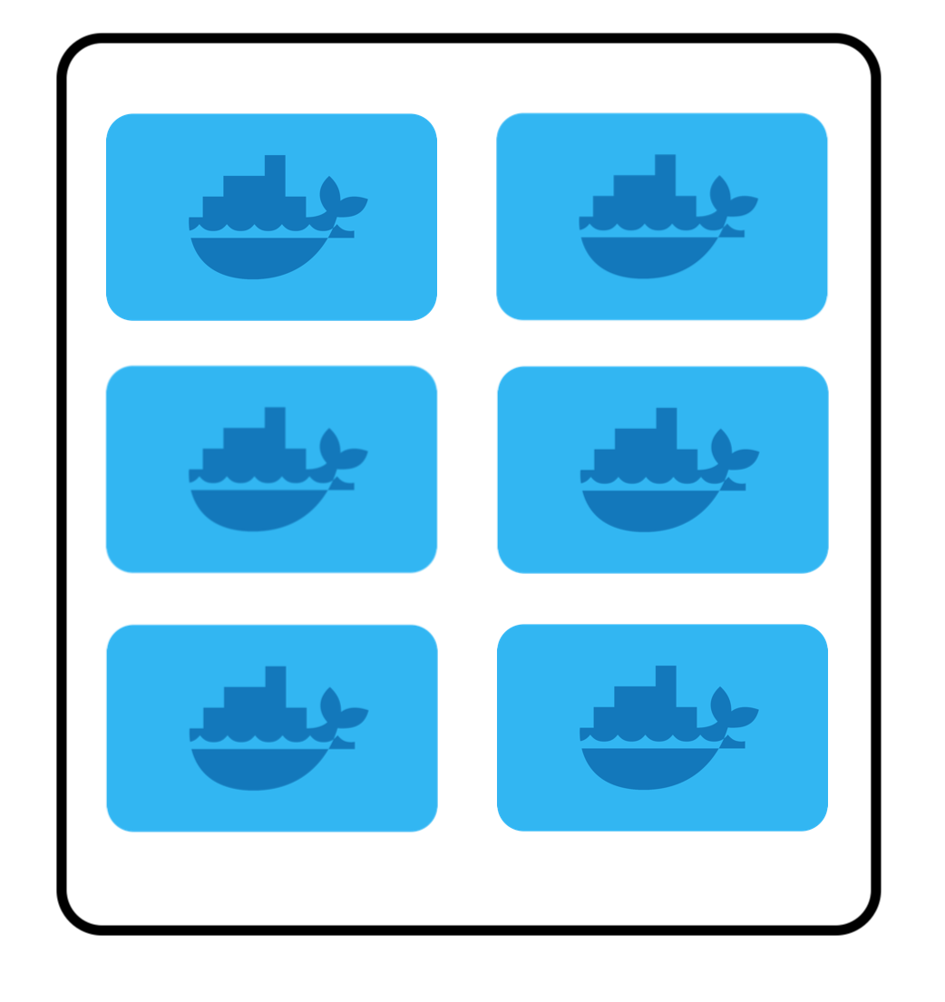
Kubernetes architecture:
YAML
Kubectl
Docker
etcd
API
Server
kubelet
kube-proxy
node-1
Controller-manager
Scheduler
Docker
kubelet
kube-proxy
master
node-2

Slide 34

Kubernetes architecture:
YAML
Kubectl
Docker
etcd
API
Server
kubelet
kube-proxy
node-1
Controller-manager
Scheduler
Docker
kubelet
kube-proxy
master
node-2

Slide 35
YAM (Declarative DSL)
Kubernetes primitives

Slide 36
Container

Slide 37
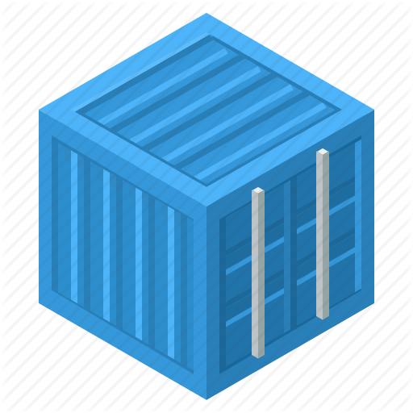
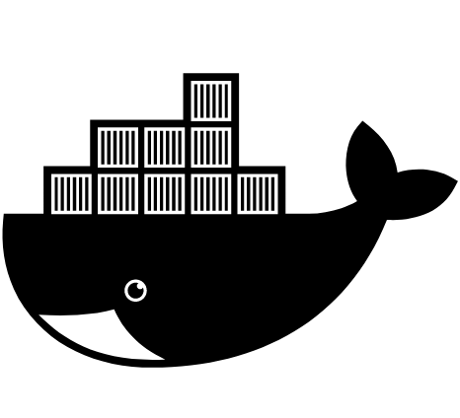

Container
Image
Command

Slide 38
Container
1. Logging
Image
3. Supervision
Command

Slide 39
Practice

Slide 40
Pod

Slide 41
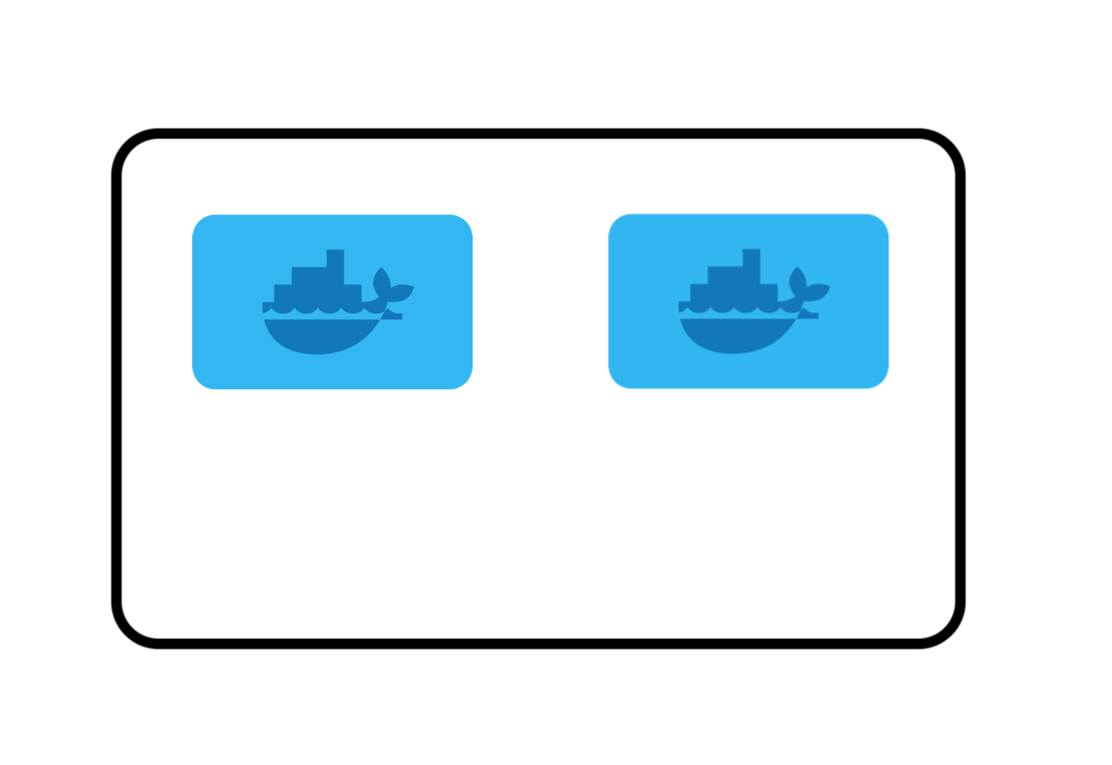

Pod

Slide 42
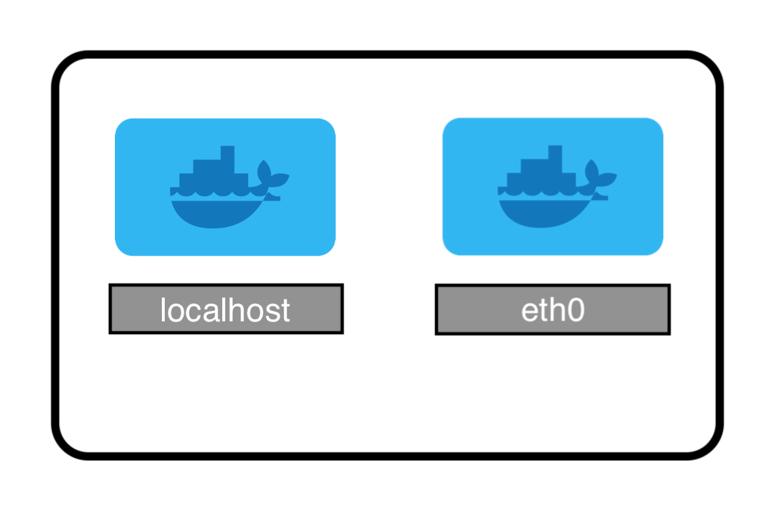
Pod

Slide 43
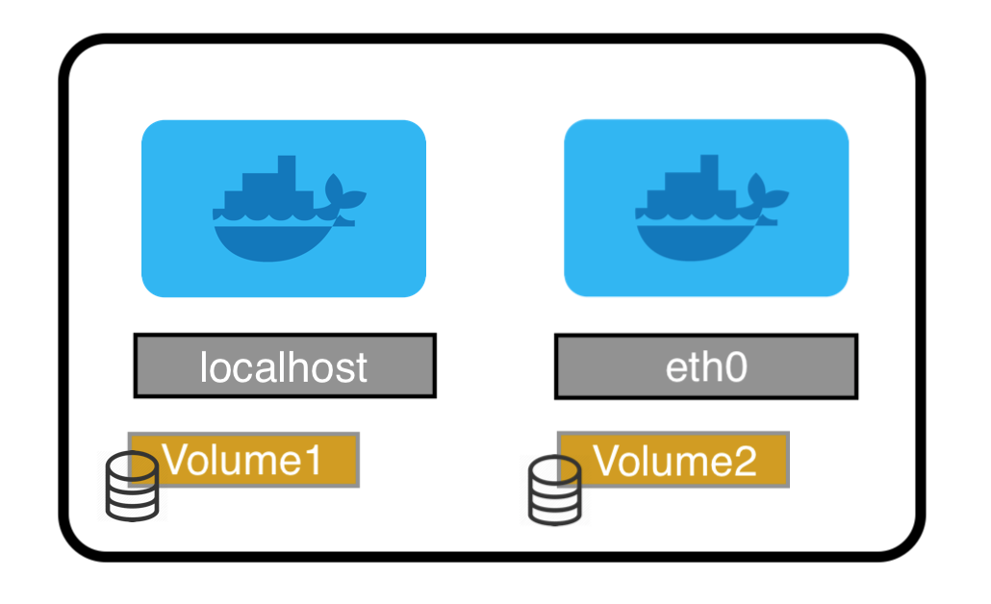
Pod

Slide 44
Pod
type=api
version=0.2.3

Slide 45

Label & Selector
type=api
version=0.2.3
name=foo

Slide 46

Label & Selector
type=api
type == api
version=0.2.3
version != 0.2.3
name=foo
name in (foo, bar)

Slide 47
Pod
type=api
version=0.2.3
6. Infrastructure automation
3. Supervision
5. Service discovery

Slide 48
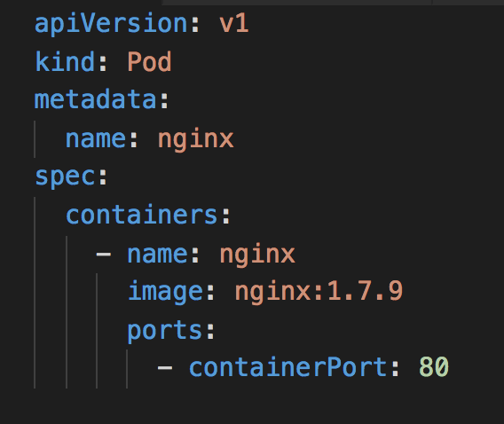
Pod

Slide 49
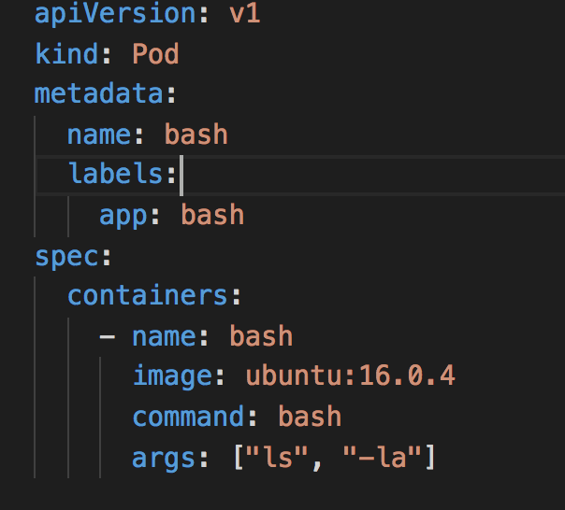
Pod

Slide 50
Practice

Slide 51
Deployment

Slide 52
Deployment
Pod
Pod
...
n

Slide 53
Deployment
Pod
Pod
...
n
+
history
Pod
Pod
...
,
Pod
Pod
...
...
0
0

Slide 54

Deployment
Pod
Pod
...
n
+
history
Pod
Pod
...
,
Pod
Pod
...
...
0
0
+
deploy

Slide 55
Deployment
Pod
Pod
...
n
+
history
Pod
Pod
...
,
Pod
Pod
...
...
0
0
+
deploy
=
Pod
n

Slide 56
Deployment
Desired | Current | Ready
2 | 2 | 2
Pod
Pod

Slide 57
Deployment
Desired | Current | Ready
2 | 2 | 2
3 | 3 | 2
Pod
Pod
Pod
Pod
Pod

Slide 58
Deployment
Desired | Current | Ready
2 | 2 | 2
3 | 3 | 2
3 | 3 | 3
Pod
Pod
Pod
Pod
Pod
Pod
Pod
Pod

Slide 59
Deployment
Desired | Current | Ready
3 | 3 | 3
Pod
Pod
Pod

Slide 60
Deployment
Desired | Current | Ready
3 | 3 | 3
1 | 3 | 1
Pod
Pod
Pod
Pod
Pod
Pod

Slide 61
Deployment
Desired | Current | Ready
3 | 3 | 3
1 | 3 | 1
1 | 1 | 1
Pod
Pod
Pod
Pod
Pod
Pod
Pod

Slide 62
Deployment
0.1.23
0.1.23
0.1.23
0.1.23
3

Slide 63
Deployment
0.1.23
0.1.23
0.1.23
0.1.23
3
0.1.24
0

Slide 64
Deployment
0.1.23
0.1.23
0.1.23
0.1.23
3
0.1.24
1

Slide 65
Deployment
0.1.23
0.1.23
0.1.23
0.1.23
3
0.1.24
0.1.24
1

Slide 66
Deployment
0.1.23
0.1.23
0.1.23
0.1.23
3
0.1.24
0.1.24
1

Slide 67
Deployment
0.1.23
0.1.23
0.1.23
2
0.1.24
0.1.24
1

Slide 68
Deployment
0.1.23
0.1.23
0.1.23
2
0.1.24
0.1.24
0.1.24
2

Slide 69
Deployment
0.1.23
0.1.23
0.1.23
2
0.1.24
0.1.24
0.1.24
2

Slide 70
Deployment
0.1.23
0.1.23
1
0.1.24
0.1.24
0.1.24
2

Slide 71
Deployment
0.1.23
0.1.23
1
0.1.24
0.1.24
0.1.24
3

Slide 72
Deployment
0.1.23
0.1.23
1
0.1.24
0.1.24
0.1.24
0.1.24
3

Slide 73
Deployment
0.1.23
0.1.23
1
0.1.24
0.1.24
0.1.24
0.1.24
3

Slide 74
Deployment
0.1.23
0
0.1.24
0.1.24
0.1.24
0.1.24
3

Slide 75
Deployment
0.1.23
0
0.1.24
0.1.24
0.1.24
0.1.24
3

Slide 76
Deployment
3. Supervision
Pod
Pod
7. (Auto) Scaling
...
n
8. CI/CD
+
history
Pod
Pod
...
,
Pod
Pod
...
...
0
0
+
deploy
=
Pod
n

Slide 77
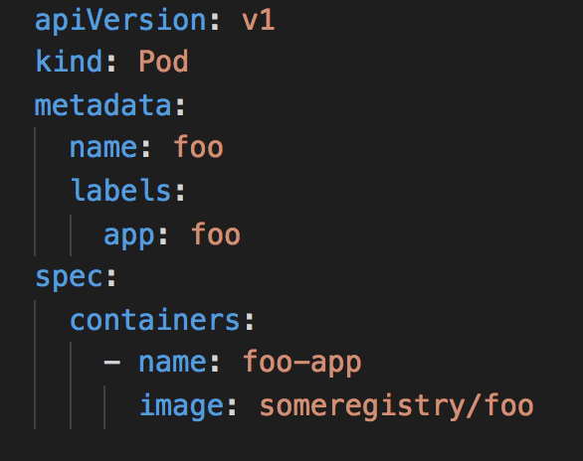
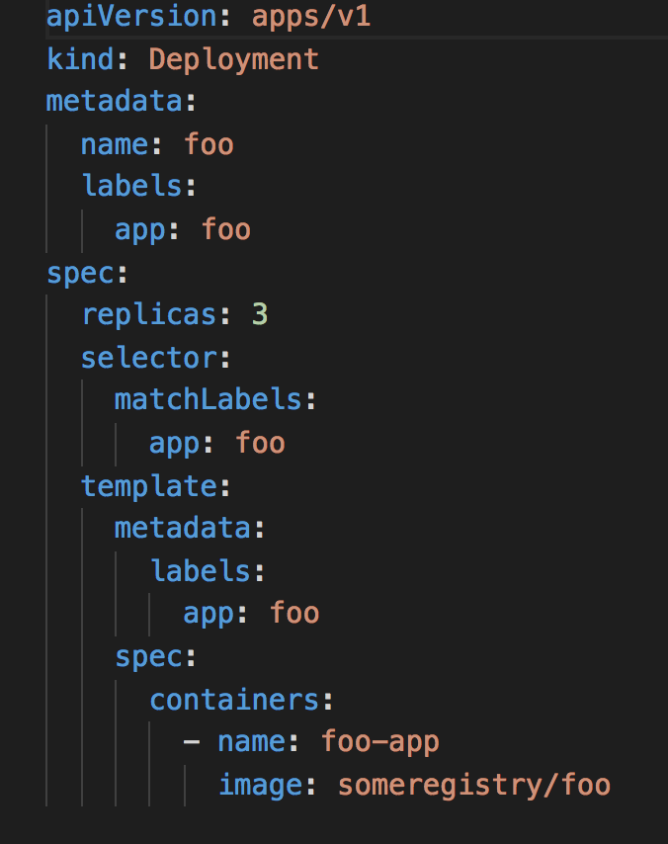
Pod
Deployment

Slide 78
Practice

Slide 79
Service

Slide 80

Service
DNS
+
Virtual IP
Service
+
Load Balancer
+
Selector

Slide 81
Service
0.1.24
0.1.24
0.1.24
0.1.24
ap=foo

Slide 82
Service
0.1.24
0.1.24
0.1.23
0.1.24
0.1.24
ap=foo
0.1.23

Slide 83
Service
0.1.24
0.1.24
0.1.24
0.1.23
0.1.24
0.1.24
0.1.24
ap=foo
0.1.23

Slide 84
Service
app=foo
0.1.24
0.1.24
app=foo
0.1.24
0.1.23
app=bar
0.1.24
0.1.24
app=foo
0.1.24
app=foo
0.1.23

Slide 85
Service
app=foo
0.1.24
0.1.24
app=foo
foo
0.1.24
0.1.23
app=bar
0.1.24
0.1.24
app=foo
0.1.24
app=foo
0.1.23

Slide 86
Service
app=foo
0.1.24
0.1.24
app=foo
foo
0.1.24
0.1.23
app=foo
app=bar
0.1.24
0.1.24
app=foo
0.1.24
app=foo
0.1.23

Slide 87
Service
app=foo
0.1.24
0.1.24
app=foo
foo
0.1.24
0.1.23
app=foo
app=bar
0.1.24
0.1.24
app=foo
0.1.24
app=foo
0.1.23

Slide 88
Service
app=foo
0.1.24
0.1.24
version=0.2.3
app=foo
foo
0.1.24
0.1.23
app=foo
app=bar
0.1.24
0.1.24
app=foo
version=0.2.3
0.1.24
app=foo
0.1.23

Slide 89
Service
app=foo
0.1.23
0.1.24
version=0.2.3
app=foo
foo
0.1.24
0.1.24
app=foo
app=bar
0.1.24
version=0.2.3
0.1.24
app=foo
version=0.2.3
0.1.24
app=foo
0.1.23

Slide 90
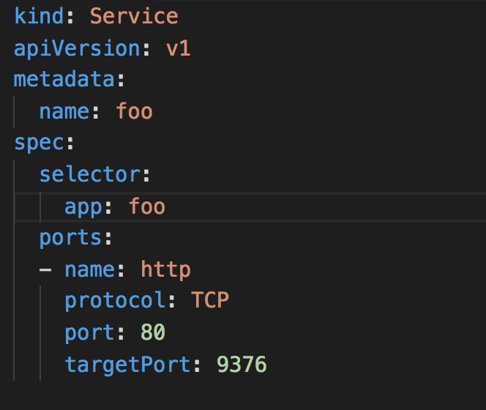
Service
app=foo

Slide 91
Practice

Slide 92
Volume

Slide 93

Volume
Size
Access Type
Storage Class
Volume

Slide 94
Volume
Size
ReadWrite (once)
Access Type
ReadOnly (many)
ReadWrite (many)
Storage Class
Volume

Slide 95
Volume
admin defined
Implementations (20)
Size
slow
EBS
normal
AzureFile
Access Type
fast
AzureDisk
Storage Class
or
CephFS
Volume
HDD
GlusterFS
SSD
...

Slide 96
Volume
Pod
Pod
Volume

Slide 97
Volume
Pod
Deployment
Pod
Pod
Pod
Pod
3
Volume
Volume

Slide 98
Secret

Slide 99

Sensitive data
Additional isolation
Secret

Slide 100
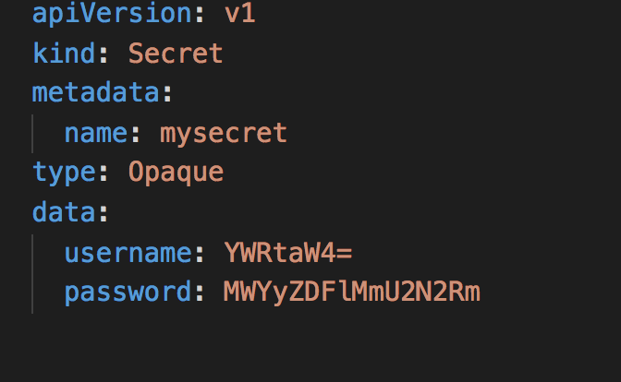

Slide 101
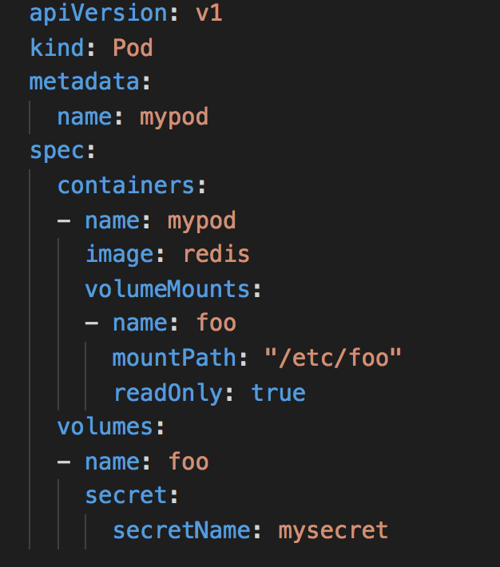

Slide 102
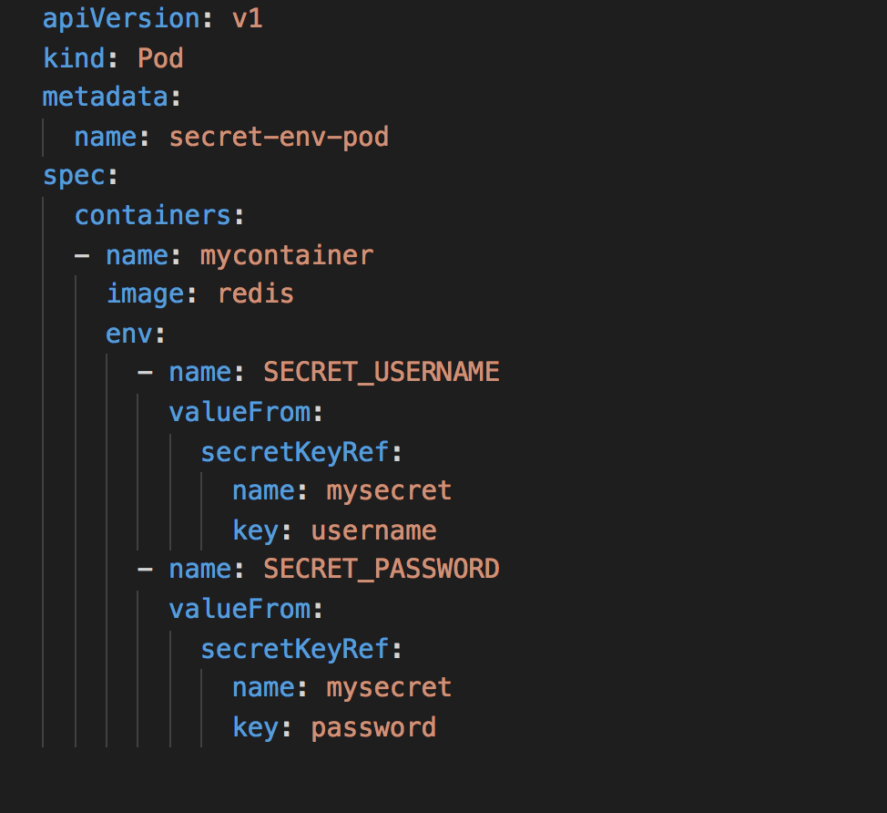

Slide 103
Practice

Slide 104
HELM

Slide 105

Helm is a kubernetes package manager.

Slide 106

Helm is a kubernetes package manager.
Tiller

Slide 107
Helm is a kubernetes package manager.
Tiller
Helm cli

Slide 108
Helm is a kubernetes package manager.
Helm charts
Tiller
Helm cli

Slide 109
Helm is a kubernetes package manager.
Helm charts
API Server
Tiller
Helm cli

Slide 110

Helm chart
Definition
Go templating
Chart values
Deploy strategy
Helm chart

Slide 111
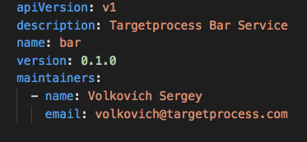
Definition
Go templating
Chart values
Deploy strategy
Helm chart

Slide 112
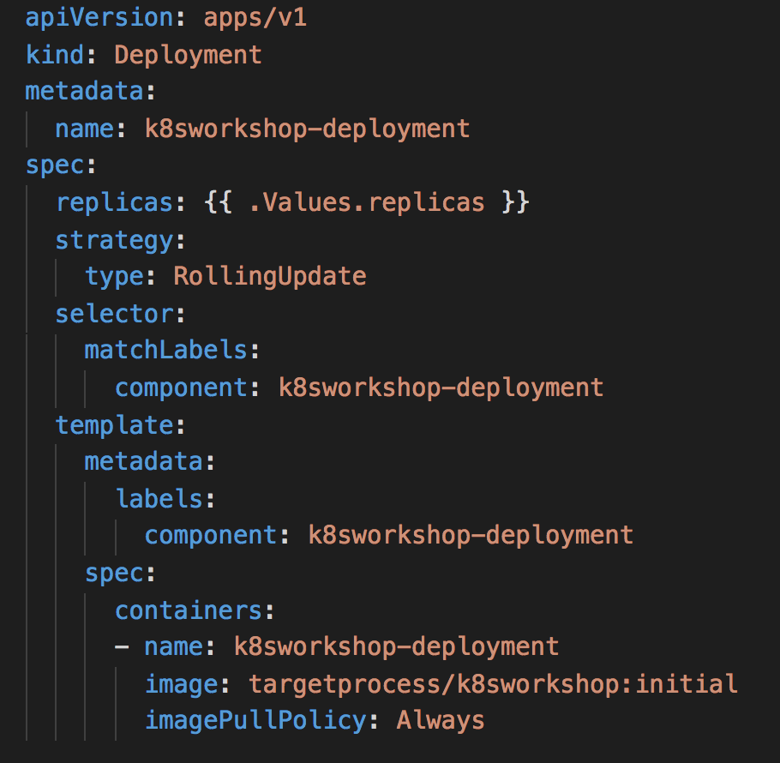
Definition
Go templating
Chart values
Deploy strategy
Helm chart

Slide 113
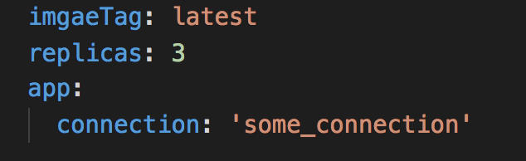
Definition
Go templating
Chart values
Deploy strategy
Helm chart

Slide 114
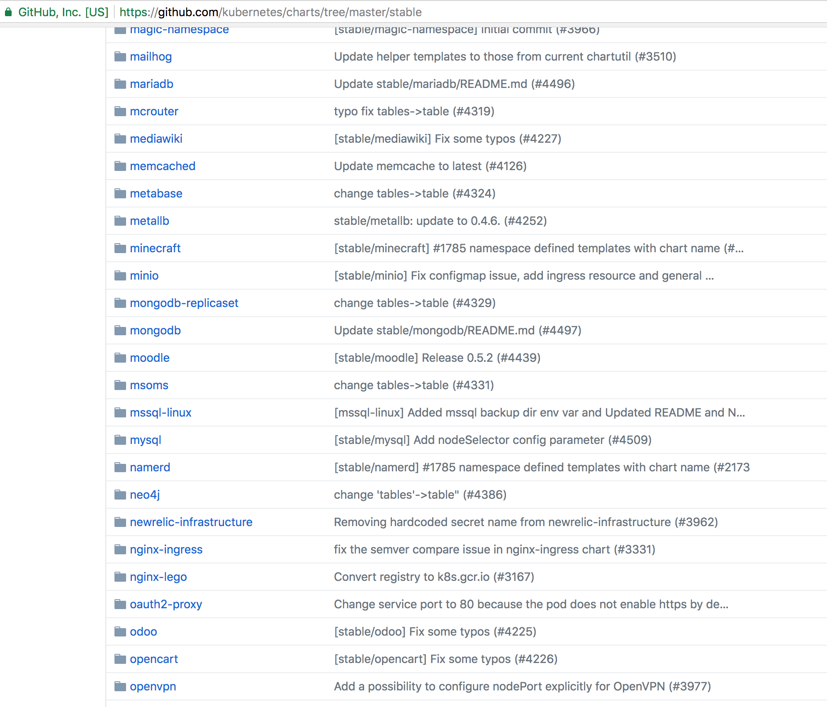

Slide 115
Helm chart
Definition
6. Infrastructure automation
Go templating
8. CI/CD
Chart values
Deploy strategy
Helm chart

Slide 116
Practice

Slide 117
Job

Slide 118

Job
Pod
Successful Completion
Job

Slide 119
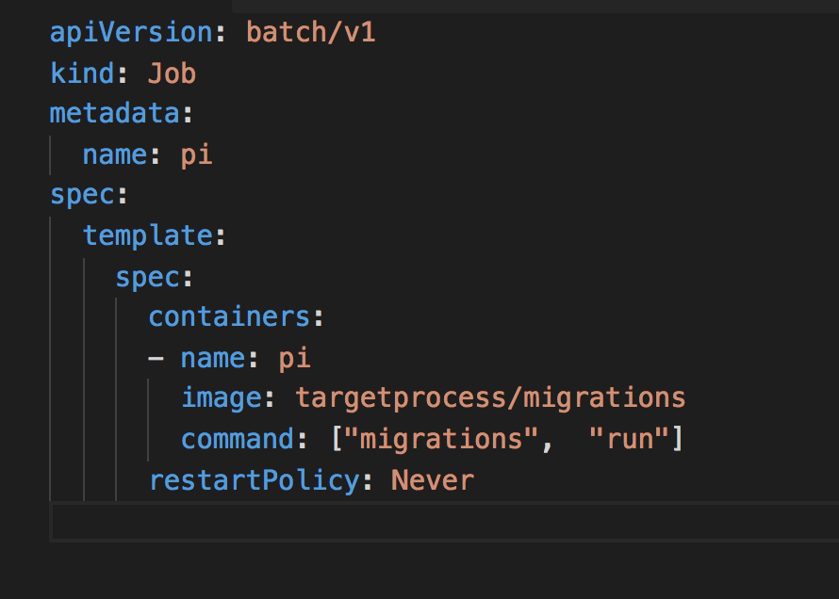
Job

Slide 120
CronJob

Slide 121

CronJob
Job
Schedule
CronJob

Slide 122
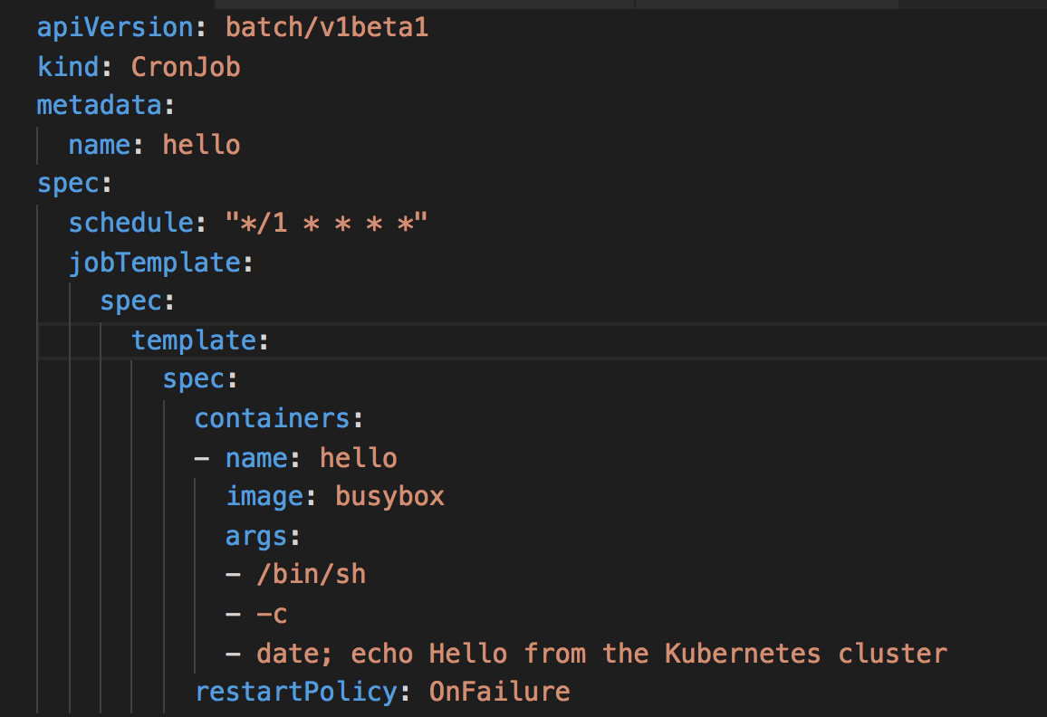
CronJob

Slide 123
Statefulset

Slide 124
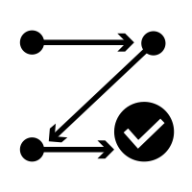
Statefulset
pod
n
pod-i
Stable names
Sequential creation
n
0-n

Slide 125
Deployment
foo
3
foo-zu3d
foo-kh3d
foo-f4nk

Slide 126
Deployment
Statefulset
foo
foo
3
0-3
foo-zu3d
foo-0
foo-kh3d
foo-1
foo-f4nk
foo-2

Slide 127
Statefulset
Deployment
Statefulset
Pod
Pod
Pod
Pod-0
Pod-1
Pod-2
3
0-3
Volume
Volume
Volume
Volume

Slide 128
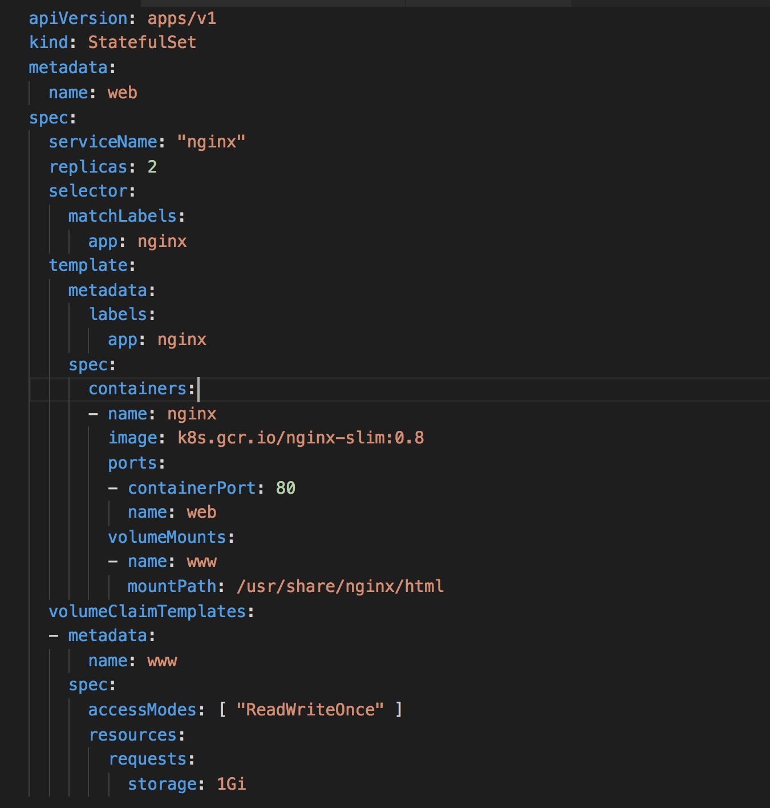

Slide 129
Daemonset

Slide 130
Daemonset
pod
pod
pod
node-1
node-2

Slide 131
Daemonset
pod
pod
pod
pod
node-1
node-2
node-3

Slide 132
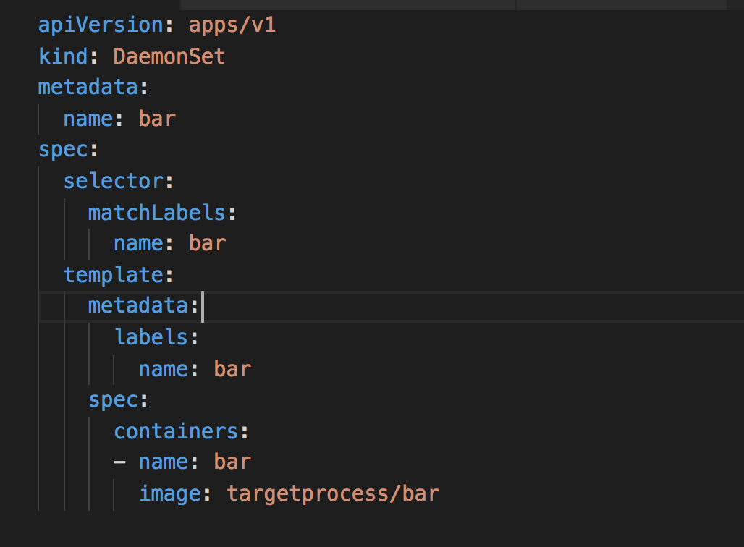

Slide 133
Ingress

Slide 134

foo
bar
foo
bar
n
n

Slide 135
public ip
public ip
foo
bar
foo
bar
n
n

Slide 136
Internet
public ip
public ip
foo
bar
foo
bar
n
n

Slide 137
Internet
public ip
public ip
foo
bar
foo
bar
foo
bar
foo
bar
n
n
n
n

Slide 138

Internet
public ip
public ip
Ingress
foo
bar
foo
bar
foo
bar
foo
bar
n
n
n
n

Slide 139
Internet
public ip
public ip
public ip
Ingress
foo
bar
foo
bar
foo
bar
foo
bar
n
n
n
n

Slide 140
Internet
Internet
public ip
public ip
public ip
Ingress
foo
bar
foo
bar
foo
bar
foo
bar
n
n
n
n

Slide 141
Ingress
Hostname
+
Path
+
Ingress
TLS
+
Service

Slide 142
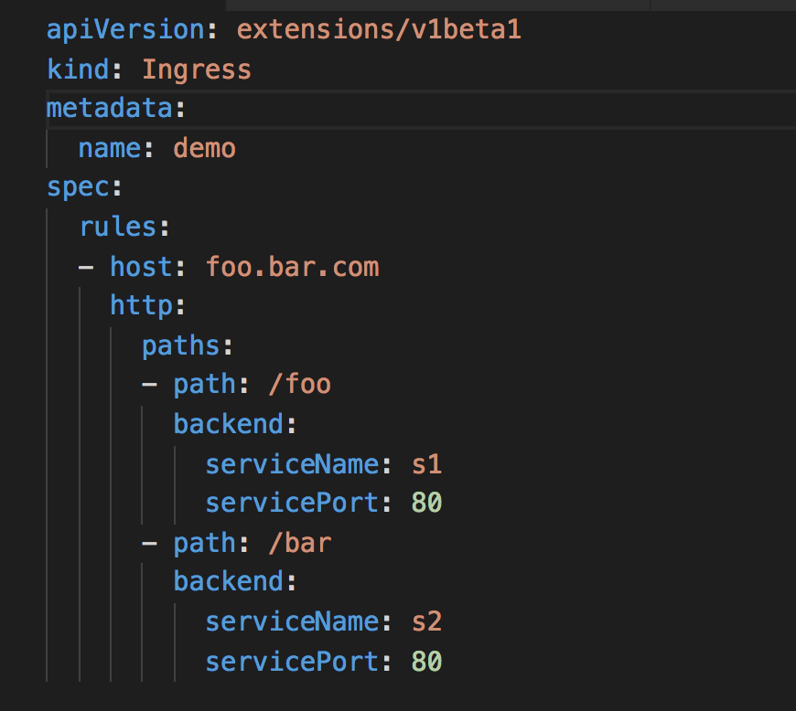
Ingress

Slide 143
Deployment | Service | Job
CronJob | Volume | Statefulset
Daemonset | Secret | Ingres
Pod
foo
Job
n
CronJob
Volume
foo
0-3
pod
Secret
Ingres

Slide 144
Conclusion

Slide 145
Infrastructure :
1. Logging
2. Metrics
3. Supervision
4. Persistence
5. Service Discovery
6. Infrastructure automation
7. (Auto) Scaling
8. CI/CD
9. Vendor Independence
10. Multi language support

Slide 146





Infrastructure :
1. Logging
2. Metrics
3. Supervision
4. Persistence
5. Service Discovery
6. Infrastructure automation
7. (Auto) Scaling
8. CI/CD
9. Vendor Independence
10. Multi language support

Slide 147
Infrastructure :
1. Logging
2. Metrics
3. Supervision
4. Persistence
5. Service Discovery
6. Infrastructure automation
7. (Auto) Scaling
8. CI/CD
9. Vendor Independence
10. Multi language support

Slide 148
Infrastructure :
1. Logging
2. Metrics
3. Supervision
4. Persistence
5. Service Discovery
6. Infrastructure automation
7. (Auto) Scaling
8. CI/CD
9. Vendor Independence
10. Multi language support

Slide 149
Infrastructure :
1. Logging
2. Metrics
3. Supervision
4. Persistence
5. Service Discovery
6. Infrastructure automation
7. (Auto) Scaling
8. CI/CD
9. Vendor Independence
10. Multi language support

Slide 150

Infrastructure :
1. Logging
2. Metrics
3. Supervision
4. Persistence
5. Service Discovery
6. Infrastructure
automation
7. (Auto) Scaling
8. CI/CD
9. Vendor Independence
10. Multi language support

Slide 151
Infrastructure :
1. Logging
2. Metrics
3. Supervision
4. Persistence
5. Service Discovery
6. Infrastructure
automation
7. (Auto) Scaling
8. CI/CD
9. Vendor Independence
10. Multi language support

Slide 152


Infrastructure :
1. Logging
2. Metrics
3. Supervision
4. Persistence
5. Service Discovery
6. Infrastructure
automation
7. (Auto) Scaling
8. CI/CD
9. Vendor Independence
10. Multi language support

Slide 153
Infrastructure :
1. Logging
2. Metrics
3. Supervision
4. Persistence
5. Service Discovery
6. Infrastructure
automation
7. (Auto) Scaling
8. CI/CD
9. Vendor Independence
10. Multi language support

Slide 154
Infrastructure :
1. Logging
2. Metrics
3. Supervision
4. Persistence
5. Service Discovery
6. Infrastructure
automation
7. (Auto) Scaling
8. CI/CD
9. Vendor Independence
10. Multi language support

Slide 155
What now?
15+ clusters in prod
100+ services in each cluster
~1h to setup cluster anywhere

Slide 156
Thank You!

